Slide 1
The Moneyball of Music
Optimizing A&R Investment Strategies via Audio Feature Analysis
Ofri Kuperberg
Management Presentation

Slide 2
The Business Problem –
The High Cost of "Gut Feeling"
Current State: A&R* decisions are currently driven by intuition and networking.
The Risk: The industry operates on a "high risk, high reward" model, but the "misses" are incredibly expensive.
The Question: We have 10 potential artists to sign. Which one warrants the capital investment?
*A&R: Artists and repertoire is the division of a record label or music publishing company that is responsible for scouting, financing, and overseeing the artistic development of recording artists and songwriters.

Slide 3

The Financial Reality
Cost to "Break" a New Artist: Major labels invest between $500,000 and $2,000,000 per artist (advances, recording, video, tour support, marketing) just to launch them in a major market.
The "Flop" Risk: Industry estimates suggest a 90% failure rate for new signings
The Opportunity: A global hit song can generate $6M+ in revenue (streaming, touring, merch) in a single year, with long-tail royalties lasting decades.
Conclusion:
  Every failed artist we choose to “break” wastes the budget required to sign a future winner.
  Missing a bound-to-success artist is a lost opportunity cost

Slide 4
The Strategic Solution
Objective: Move from a "Spray and Pray" approach to Data-Driven Filtering.
Method: Use historical audio data over 20 years to predict the probability of commercial success before allocating the full marketing budget.
KPIs for Success:
  Cost Reduction:
  Reduce waste from 90% (Industry Standard) to ~30%
  Revenue Efficiency:
  Increase the "Hit Rate" from 1 in 10 (10%) to 7 in 10 (70%)

Slide 5
The Dataset
Dataset file : “15,000 Music Tracks - 19 Genres (w/SpotifyData)”
Dataset source: Kaggle Link
3000+ songs from the last 20 years
How do we define a Hit? – Using Spotify popularity measurement, we take the top 30% songs
Our features: genre + 13 Spotify audio features. Such as:
Danceability - A measure of how suitable the track is for dancing, ranging from 0.0 to 1.0.
Tempo - The speed of the track in beats per minute (BPM).
Energy - Energy is a measure from 0.0 to 1.0 and represents a perceptual measure of intensity and activity

Slide 6
The Moneyball of Music
Optimizing A&R Investment Strategies via Audio Feature Analysis
Ofri Kuperberg
Technical Presentation

Slide 7
The Dataset
15,000 songs
18 columns overall
Metadata columns (name, etc.)
Audio features columns:
Energy (0.0–1.0): Perceptual intensity (fast/loud/noisy) based on dynamic range and timbre.
Example: Bach (Low) vs. Death Metal (High).
Loudness (-60–0 dB): The overall loudness of a track in decibels
Tracks with high valence sound more positive (e.g., happy, cheerful, euphoric), while tracks with low valence sound more negative (e.g., sad, depressed, angry).
Instrumentalness (0.0 – 1.0): Likelihood of no vocals (Values > 0.5 are instrumental).
Valence (0.0-1.0): A measure from 0.0 to 1.0 describing the musical positiveness conveyed by a track.

Slide 8
Data Pipeline
Filtering:
  Focused on the modern era (2000s–Present) to ensure investment relevance (trends change).
  Removed duplicated songs (same song and artist name)
    Total duplicate rows (same name & artist after normalization): 104 (3%)
  No missing data
EDA:
  Class Imbalance:
    Hit songs: 1023
    Non-hit songs : 2346
  Artist diversity: high
    610 artists, mean song per artist 5.52, median 6
    only 22.95% have >8 songs.
    low risk of artist-driven bias
  Outliers:
    Some audio features have many outliers
    Some have none or close to none
    We use a random forest model, and these outliers have meaning, so we keep them

Slide 9
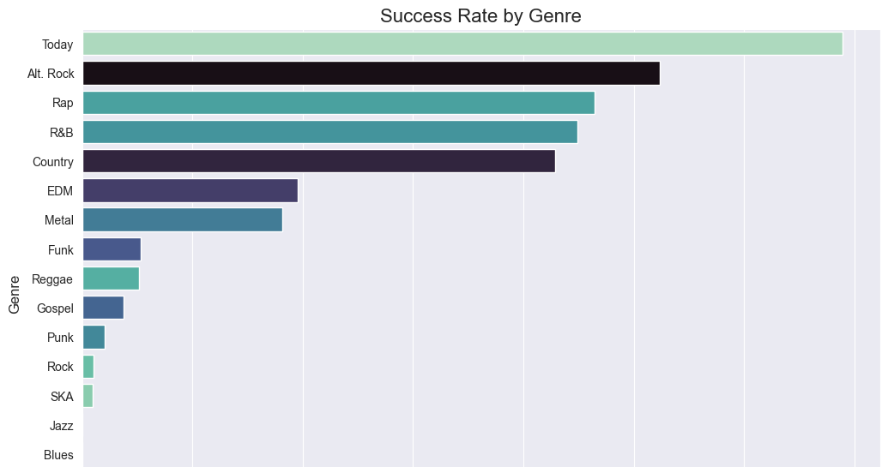

Slide 10
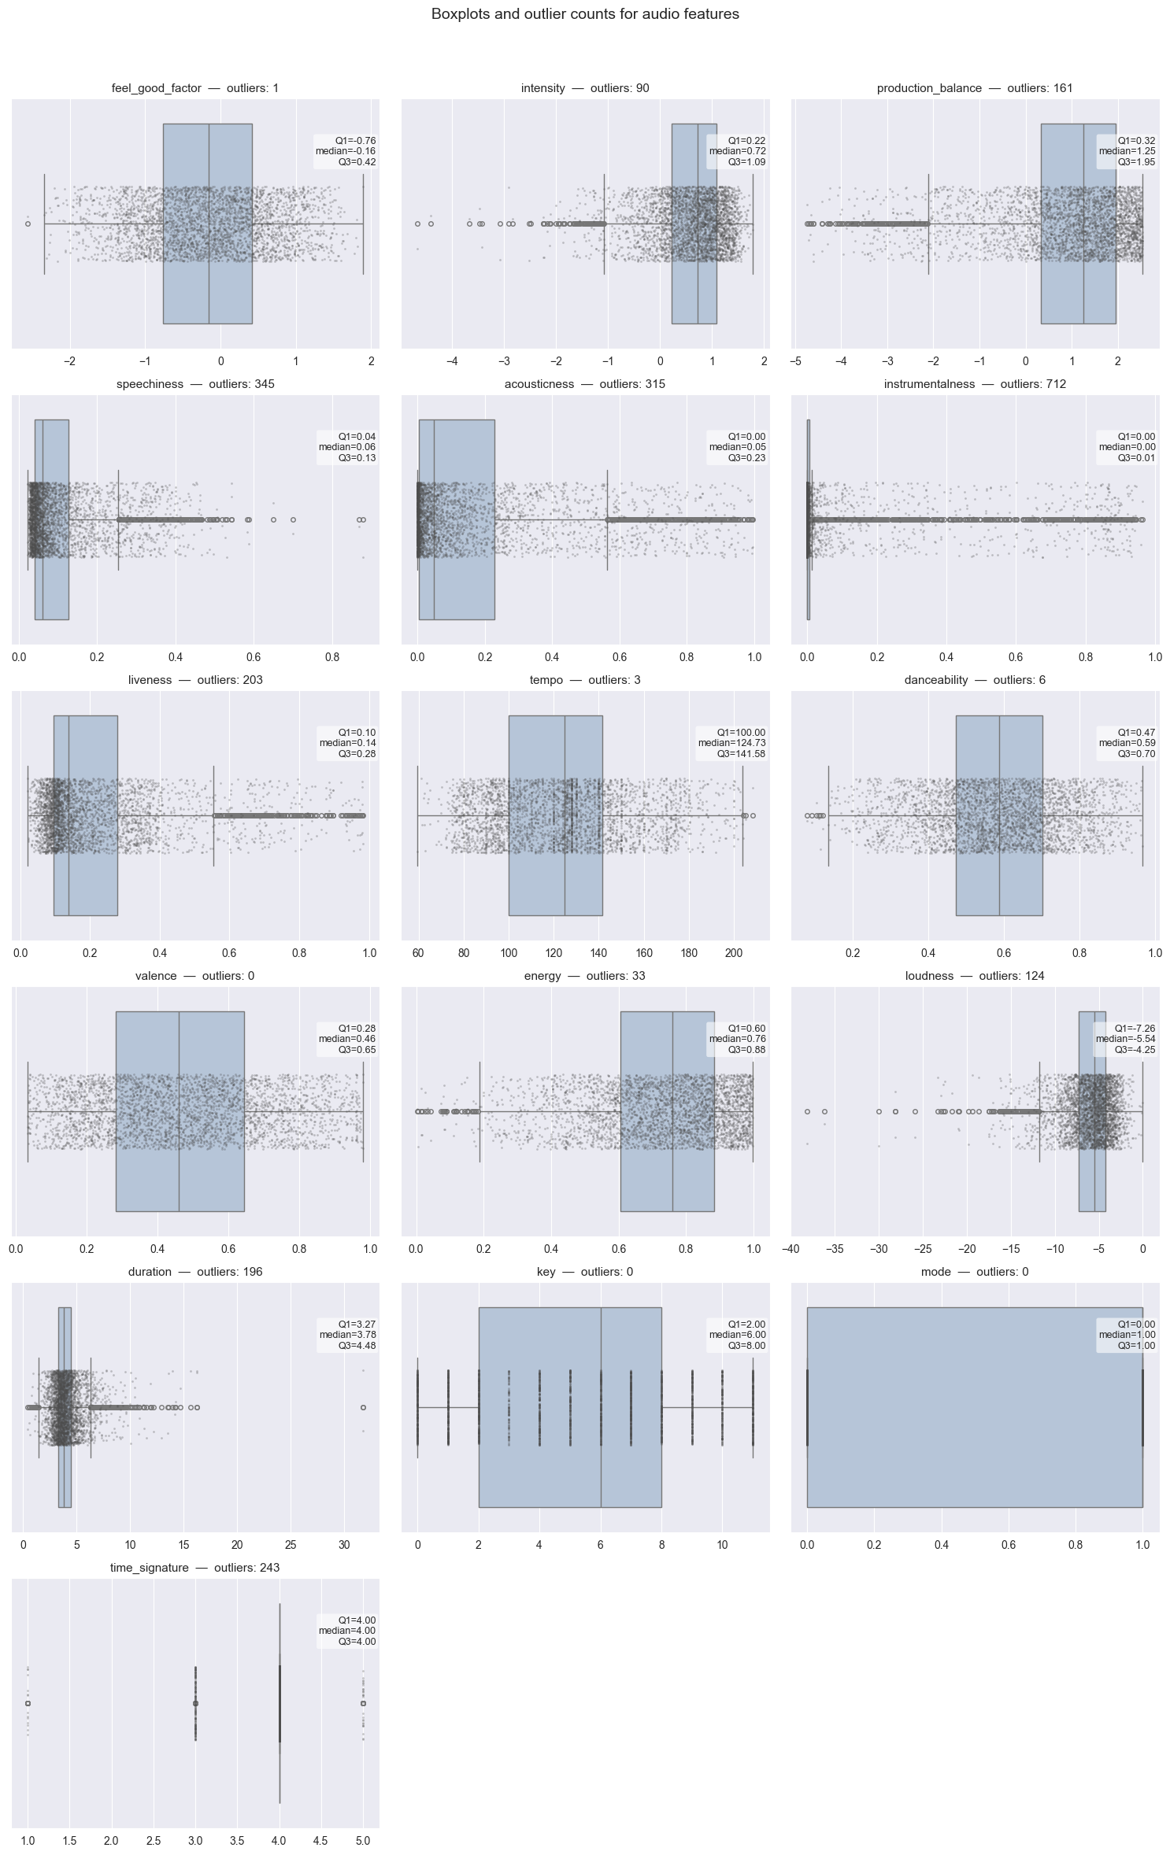
Audio features distribution

Slide 11
Feature Engineering
We engineered features to capture relationships between audio features
  Intensity (Energy + Loudness):
    The "Radio Ready" factor.
  Feel_Good_Factor (Valence + Danceability):
    Viral/TikTok potential.
  Production_Balance:
    Distinguishing acoustic niche tracks from produced pop hits.
How we created these features
after scaling by standardization for each column
Intensity : (energy + loudness) / 2 (mean of both)
Feel_Good_Factor: (valence + danceability) / 2
Production_Balance: energy – acousticness (the distance between them)

Slide 12
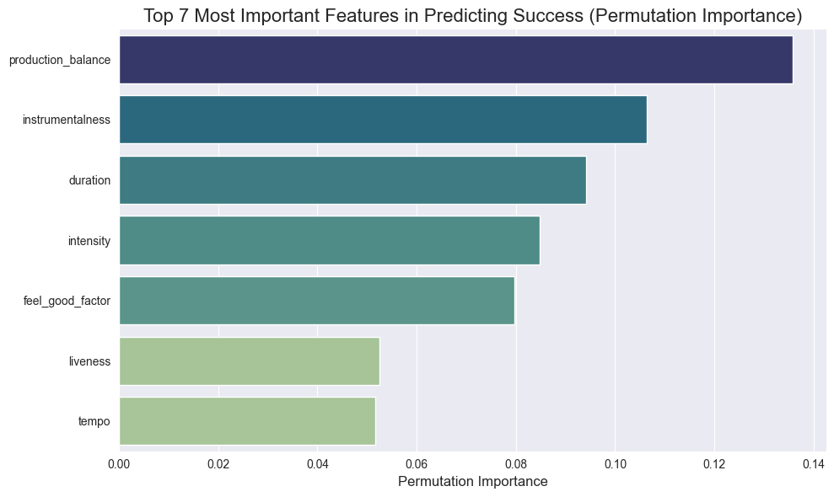

Slide 13
Model Strategy & Selection
Algorithm:
Random Forest Classifier.
Why?
Handles outliers well
Isn’t effected by multicollinearity
Handles Mixed feature type & Nonlinear relationships
Built-in OOB error estimation

Slide 14
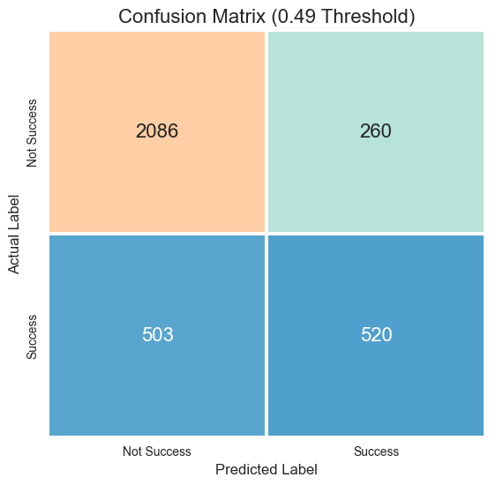
Results & Interpretation
Accuracy: ~78% (Overall).
Precision (Success Class): 67%.
Recall (Success Class): 51%

Slide 15
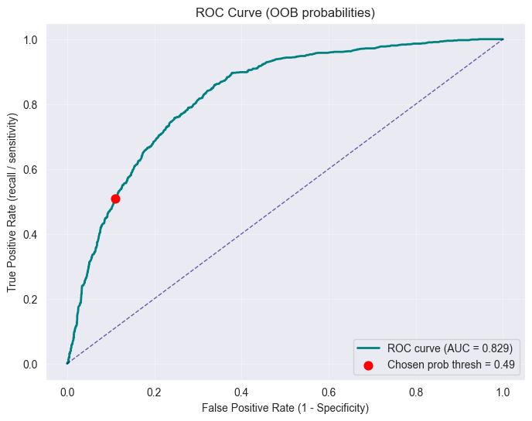
ROC & AUC

Slide 16

Value Proposition
Ofri Kuperberg

Slide 17
Why It Works & Future Outlook
Why the model succeeds
It Listens to Context, Not Just Noise:
Old methods looked at one thing at a time (e.g., "Is it fast?").
Our model looks at combinations (e.g., "Is it fast AND sad?" or "Is it loud BUT slow?"). This is how we actually listen to music.
We Taught It "Vibe":
We didn't just feed it raw numbers. We created special metrics like "Intensity" and "Danceability Index" that measure the song's energy and potential to go viral in clubs or playlists.
The Challenge: Music trends change fast. A hit song in 2000 sounds nothing like a hit song today.
The Solution: We treat the model like a living employee
Quarterly Updates: Every 3 months, we "teach" the model the latest Top 100 songs.
Result: It constantly learns what the current audience wants, so it never gets stuck in the past.

Slide 18
Cost-Effectiveness Analysis
  Implementation Cost: Low. The model runs on standard cloud infrastructure (minimal compute cost) using open-source libraries (Python/Scikit-Learn).
  The cost of one bad signing is ~$1M.
  Capital Efficiency: By reducing our "Wasted Capital Ratio" from 90% to <35%, we effectively triple our purchasing power for marketing
  Before Model:
    Invest in 10 artists→1 Hit ($6M Return), 9 Flops ($9M Loss).
    Net Result: -$3M Loss.
  After Model
    screen 50 candidates → Model identifies top 10 "Likely Successes".
    Outcome (69% Precision): ~7 Hits ($42M Return), 3 Flops ($3M Loss).
    Net Result: +$39M Profit.

Slide 19
Final Recommendation
Integrate: Use this model as "Phase 1" screening for all demo submissions.
Focus: Prioritize signing artists with high Energy and Danceability metrics (as per feature importance).
Refine: Research and look for more songs features that can increase the model prediction power per song.

